Slide 1
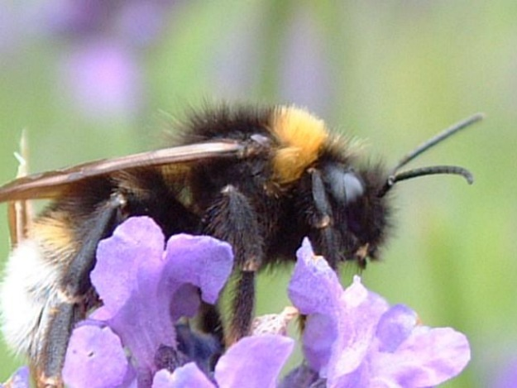
5.5: Integral as Net Change
Greg Kelly, Hanford High School, Richland, Washington

Slide 2


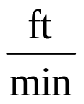


A honey bee makes several trips from the hive to a flower garden.
The velocity graph is shown below.
What is the total distance traveled by the bee?
700 feet
200ft
200ft
200ft
100ft

Slide 3

What is the displacement of the bee?
100 feet away from the hive
200ft
200ft
-200ft
-100ft

Slide 4
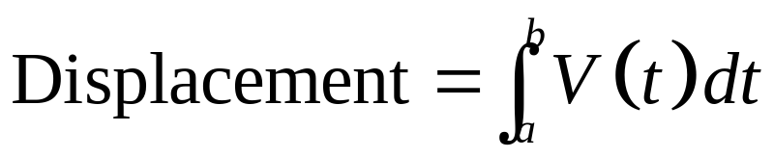
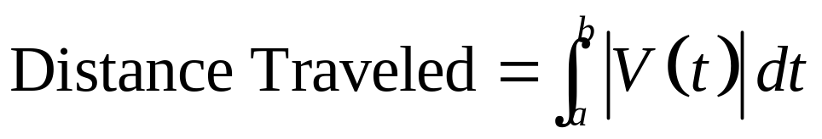
To find the displacement (position shift) from the velocity function, we just integrate the function. The negative areas below the x-axis subtract from the total displacement.
To find distance traveled we have to use absolute value.
Find the roots of the velocity equation and integrate in pieces, similar to when you find the area between a curve and the x-axis. (Take the absolute value of each integral.)
Or you can use your calculator to integrate the absolute value of the velocity function.

Slide 5
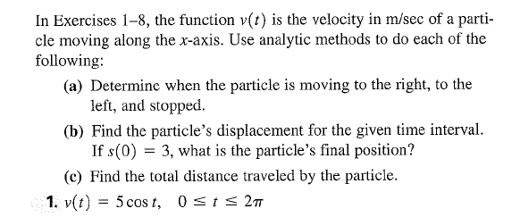
Now You Try!

Slide 6
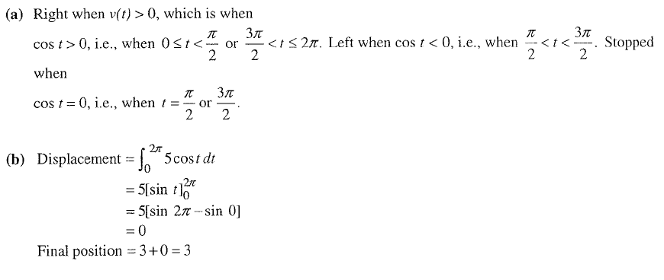
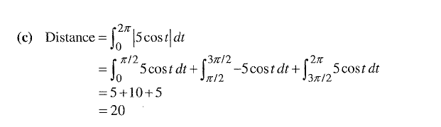

Slide 7
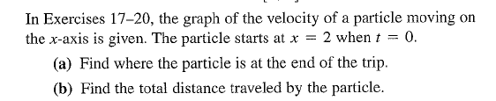
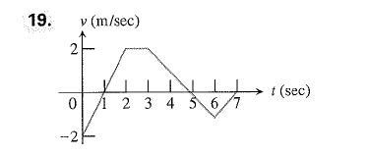
Now you try!

Slide 8
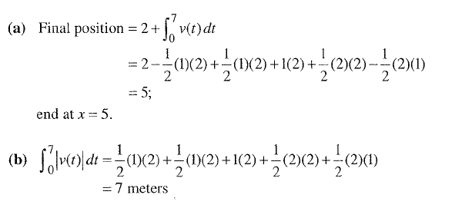
Solution

Slide 9
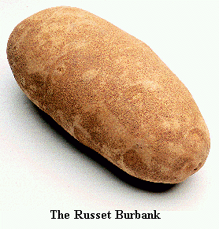
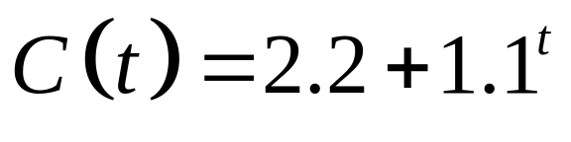
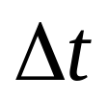
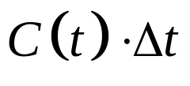
Example 5:
National Potato Consumption
The rate of potato consumption for a particular country was:
where t is the number of years since 1970 and C is in millions of bushels per year.
For a small , the rate of consumption is constant.
The amount consumed during that short time is .

Slide 10
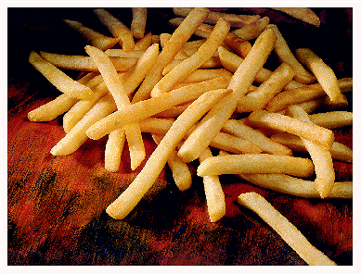
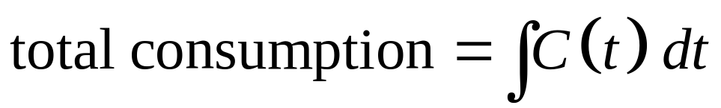
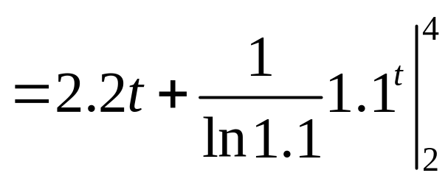
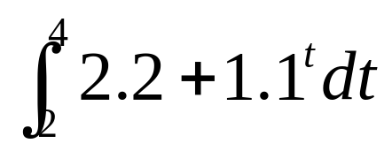

Example 5:
National Potato Consumption
The amount consumed during that short time is .
We add up all these small amounts to get the total consumption:
From the beginning of 1972 to the end of 1973:
million bushels

Slide 11
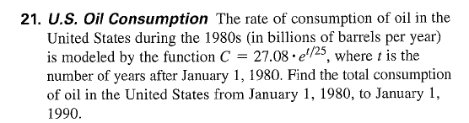
Now You Try!

Slide 12
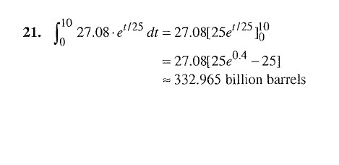
Solution

Slide 13
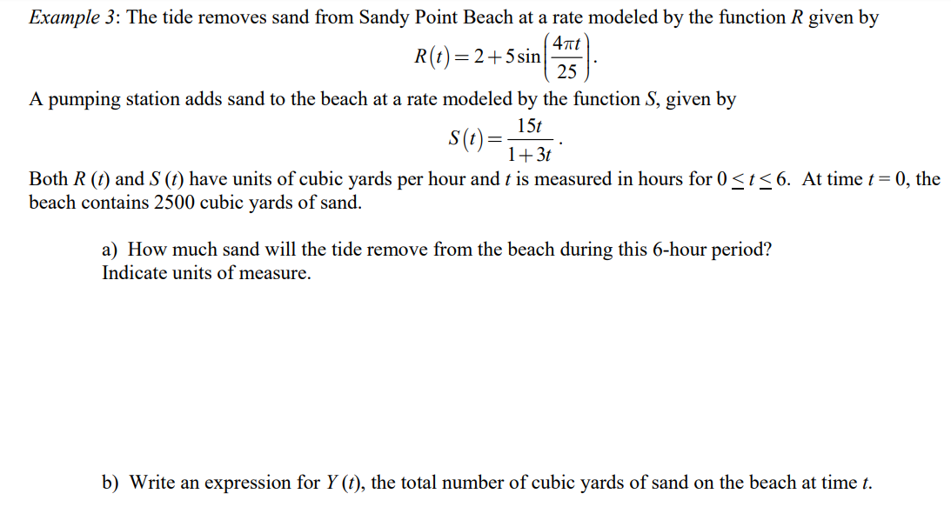
Net Change Practice
Notes:
a = 31.816 cubic yards of sand, b = intial + integral of s minus r

Slide 14
5.5 Net Change
Pg. 326: #1, #2, #9, #12
#1 and #2 you can use your calculator. Be careful on #2!
#9 and #12 you should do displacement without your calculator and with the unit circle. Use your calculator for total distance.

